Slide 1
CPSC 583 Expert Systems Design Theory
Dr. Anand Panangadan
apanangadan@fullerton.edu

Slide 2
Knowledge engineering
Knowledge Engineer:
Investigates a particular domain
Learns what concepts are important in that domain
Creates a formal representation of the objects and relations in that domain

Slide 3
Knowledge engineering
Special-purpose knowledge bases
Electronic circuits
Actions (Situation Calculus)
General-purpose knowledge bases
Represent classes of objects and relationships between classes
Events
Time
Semantic Web

Slide 4
Knowledge engineering process
Identify the task
Assemble the relevant knowledge
Decide on a vocabulary
Encode general knowledge about the domain
Encode a description of the specific problem instance
Pose queries and get answers
Debug the knowledge base
Chapter 8.4.1 of Artificial Intelligence: A Modern Approach

Slide 5
Knowledge engineering
Electronic circuits

Slide 6
Electronic circuit verification
Chapter 8.4.2 of Artificial Intelligence: A Modern Approach

Slide 7
Electronic circuits
Identify the task
Does the circuit implement the desired functionality?
List all gates connected to a specific input
Does the circuit contain loops
What is the timing delay?
What is the circuit area?
…

Slide 8
Electronic circuits
Assemble the relevant knowledge
Does the circuit implement the desired functionality?

Slide 9
Electronic circuit verification
Concepts in the domain
Gates
Four types of gates (AND, OR, NOT, XOR)
Gates have terminals
Input
Output
Wires
Wires connect terminals of gates
Signals flow along wires
Signals can be 0 or 1

Slide 10
Electronic circuits: decide the Vocabulary
Predicates and objects
Variables representing gates
Constants: X1, X2,…
Gate(X1) predicate
Type of gate function
Constants: AND, OR, XOR, NOT
Type(X1) = XOR

Slide 11
Electronic circuit verification
Predicates:
Terminal(x)
Gate or circuit can have more than one terminal
Function In(1,X1): 1st input terminal of X1
Function Out(1,X1): 1st output terminal of X1

Slide 12
Electronic circuit verification
Predicate:
Connected(t1, t2)
Function:
Signal(t) = 0 or 1
Equality predicate
Equals(x,y)
~Equals(0,1)

Slide 13
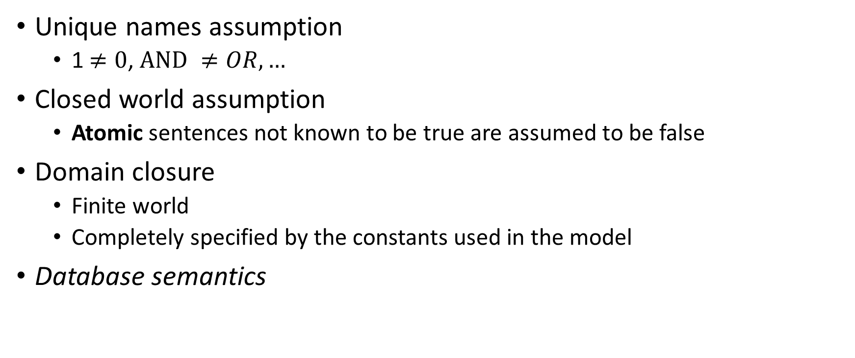
Simplifying assumptions
Unique names assumption
1 $≠0$, $AND ≠OR, …$
Closed world assumption
Atomic sentences not known to be true are assumed to be false
Domain closure
Finite world
Completely specified by the constants used in the model
Database semantics

Slide 14
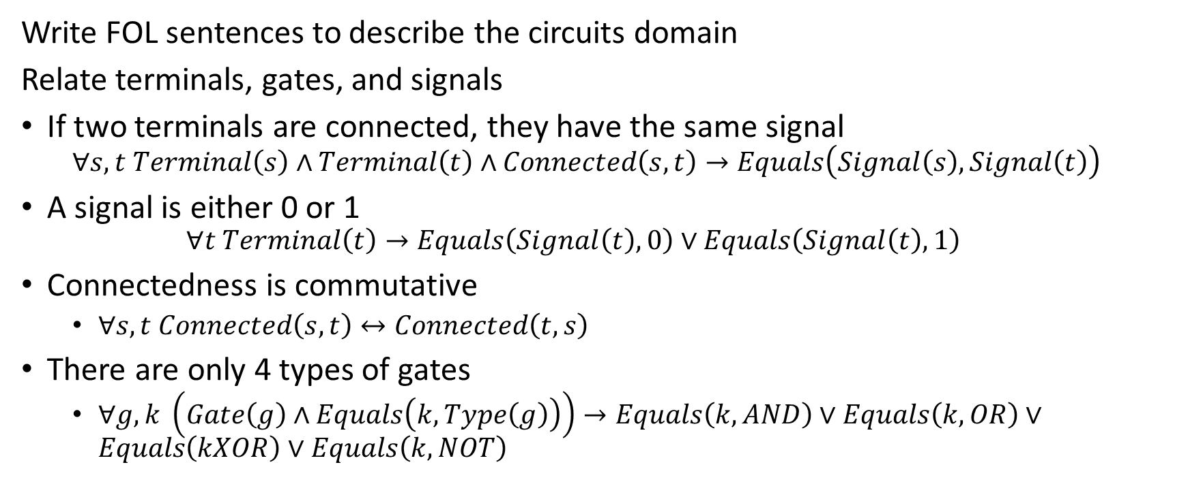
Encode general knowledge of circuits
Write FOL sentences to describe the circuits domain
Relate terminals, gates, and signals
If two terminals are connected, they have the same signal
$$∀s,t Terminal\left(s\right)∧Terminal\left(t\right)∧Connected\left(s,t\right)→Equals\left(Signal\left(s\right),Signal\left(t\right)\right)$$
A signal is either 0 or 1
$$∀t Terminal\left(t\right)→Equals\left(Signal\left(t\right),0\right)∨Equals\left(Signal\left(t\right),1\right)$$
Connectedness is commutative
$∀s,t Connected\left(s,t\right)↔Connected\left(t,s\right)$
There are only 4 types of gates
$∀g,k \left(Gate\left(g\right)∧Equals\left(k,Type\left(g\right)\right)\right)→Equals\left(k,AND\right)∨Equals\left(k,OR\right)∨$ $Equals\left(kXOR\right)∨$ $Equals\left(k,NOT\right)$

Slide 15
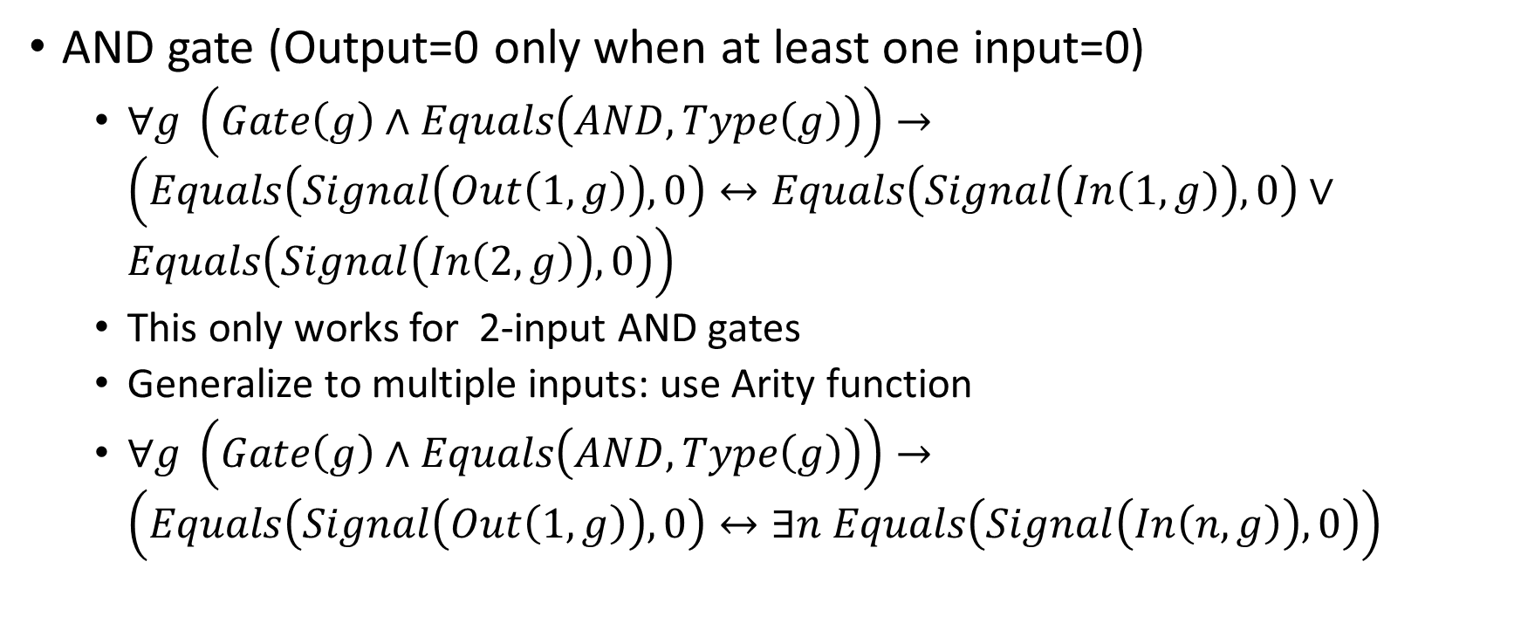
Write FOL sentences to describe the circuit
AND gate (Output=0 only when at least one input=0)
$∀g \left(Gate\left(g\right)∧Equals\left(AND,Type\left(g\right)\right)\right)→\left(Equals\left(Signal\left(Out\left(1,g\right)\right),0\right)↔Equals\left(Signal\left(In\left(1,g\right)\right),0\right)∨Equals\left(Signal\left(In\left(2,g\right)\right),0\right)\right)$
This only works for 2-input AND gates
Generalize to multiple inputs: use Arity function
$∀g \left(Gate\left(g\right)∧Equals\left(AND,Type\left(g\right)\right)\right)→\left(Equals\left(Signal\left(Out\left(1,g\right)\right),0\right)↔∃n Equals\left(Signal\left(In\left(n,g\right)\right),0\right)\right)$

Slide 16
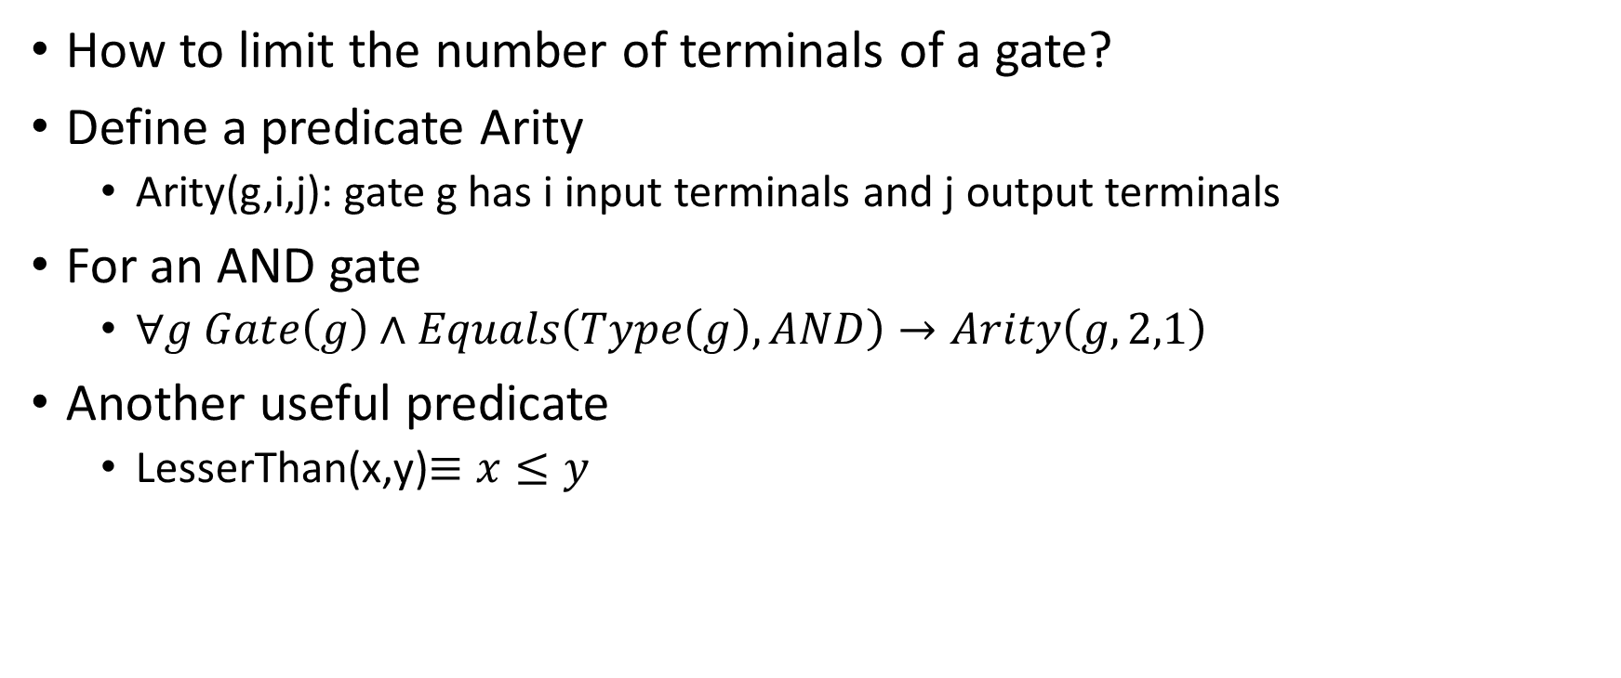
Electronic circuit verification
How to limit the number of terminals of a gate?
Define a predicate Arity
Arity(g,i,j): gate g has i input terminals and j output terminals
For an AND gate
$∀g Gate\left(g\right)∧Equals\left(Type\left(g\right),AND\right)→Arity\left(g,2,1\right)$
Another useful predicate
LesserThan(x,y)$≡x≤y$

Slide 17
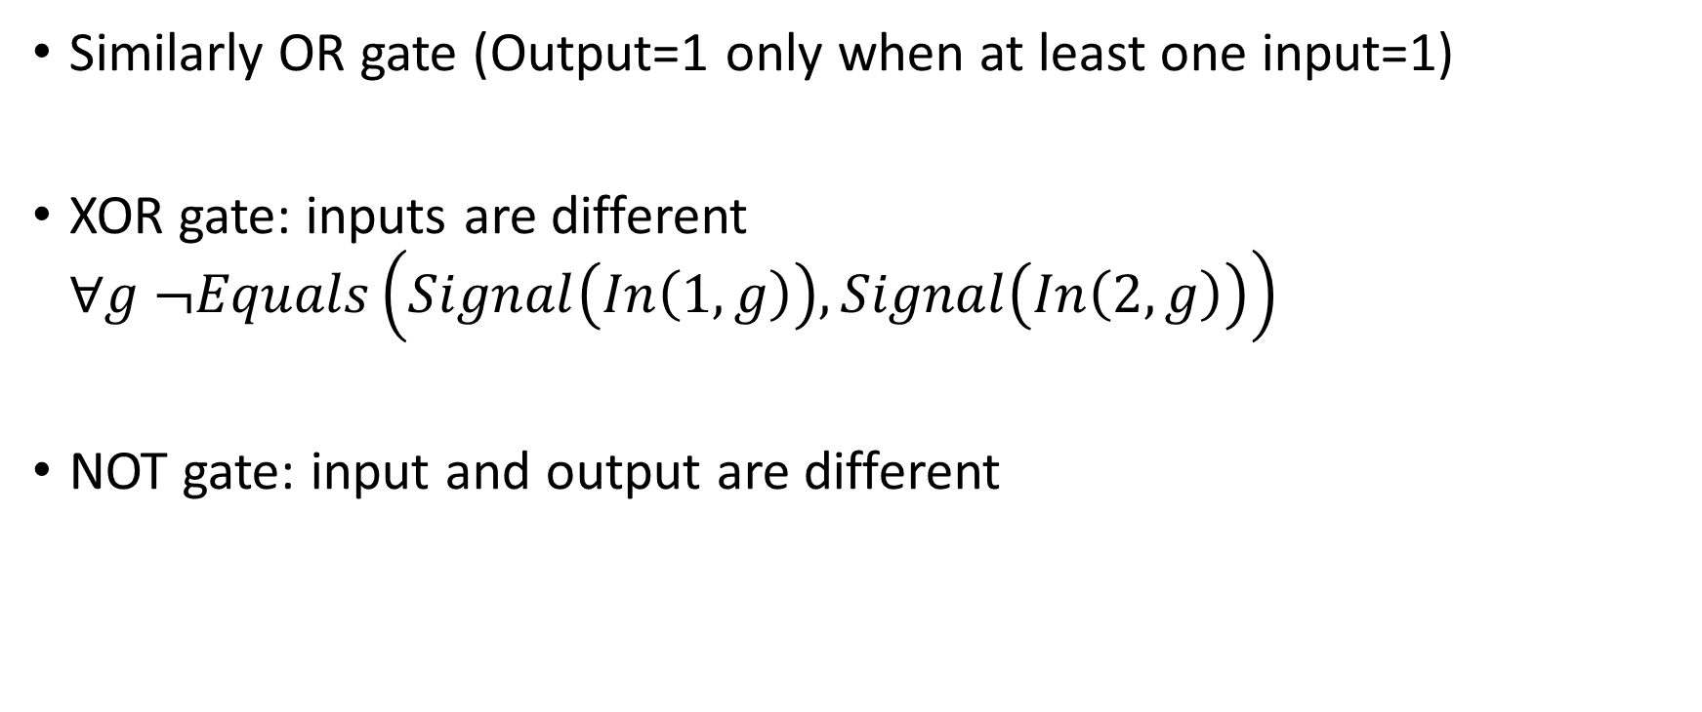
Write FOL sentences to describe the circuit
Similarly OR gate (Output=1 only when at least one input=1)
XOR gate: inputs are different $∀g ¬Equals\left(Signal\left(In\left(1,g\right)\right),Signal\left(In\left(2,g\right)\right)\right)$
NOT gate: input and output are different

Slide 18

Unique names assumption
$∀g,t Gate\left(g\right)∧Terminal\left(t\right)→¬Equals\left(g,t\right)$
Similarly
$g≠1,g≠0$ (valid values for gates)
$t≠1,t≠0,t≠AND, …$ (valid values for terminals)
Valid values for signals ….

Slide 19
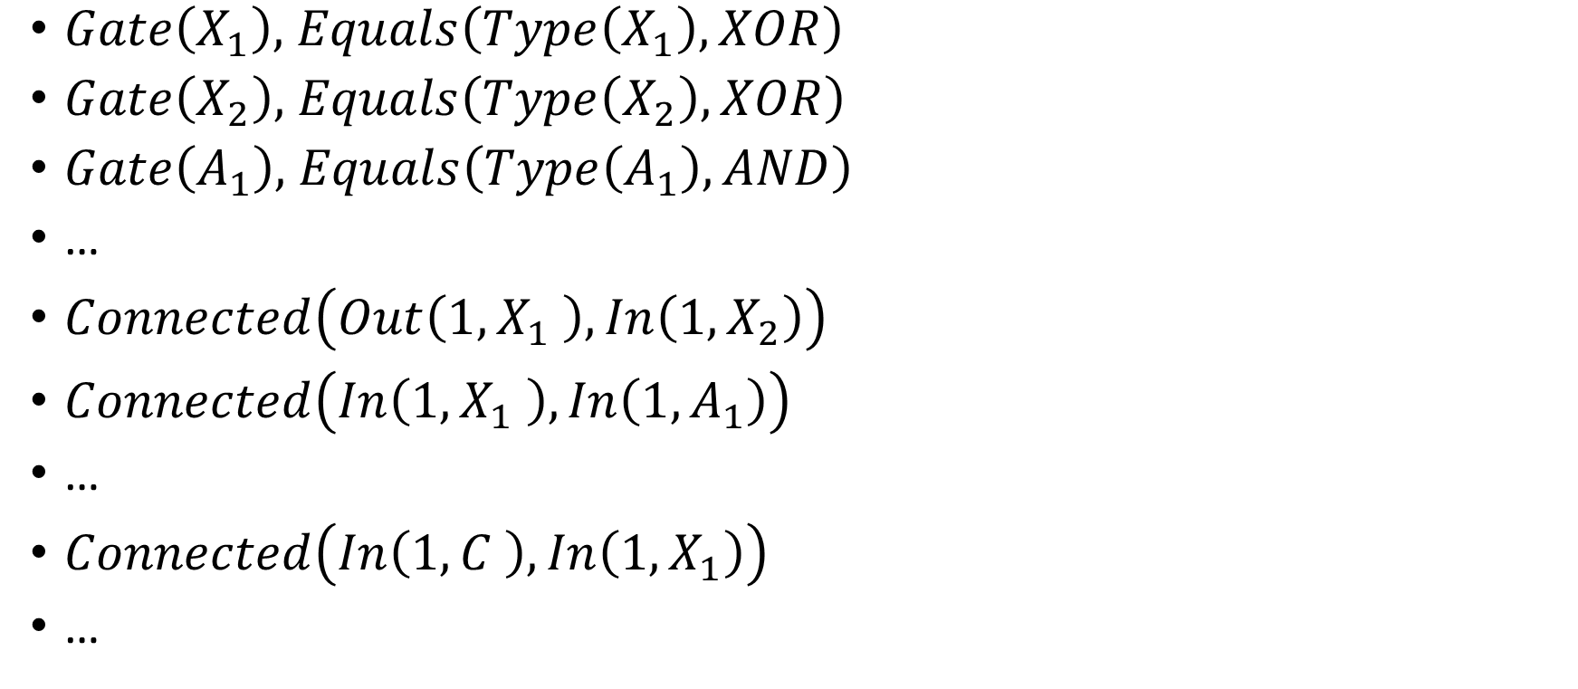
Encode the specific problem instance
$Gate\left(X_{1}\right),$ $Equals\left(Type\left(X_{1}\right),XOR\right)$
$Gate\left(X_{2}\right),$ $Equals\left(Type\left(X_{2}\right),XOR\right)$
$Gate\left(A_{1}\right),$ $Equals\left(Type\left(A_{1}\right),AND\right)$
…
$Connected\left(Out\left(1,X_{1} \right),In\left(1,X_{2}\right)\right)$
$Connected\left(In\left(1,X_{1} \right),In\left(1,A_{1}\right)\right)$
…
$Connected\left(In\left(1,C \right),In\left(1,X_{1}\right)\right)$
…

Slide 20
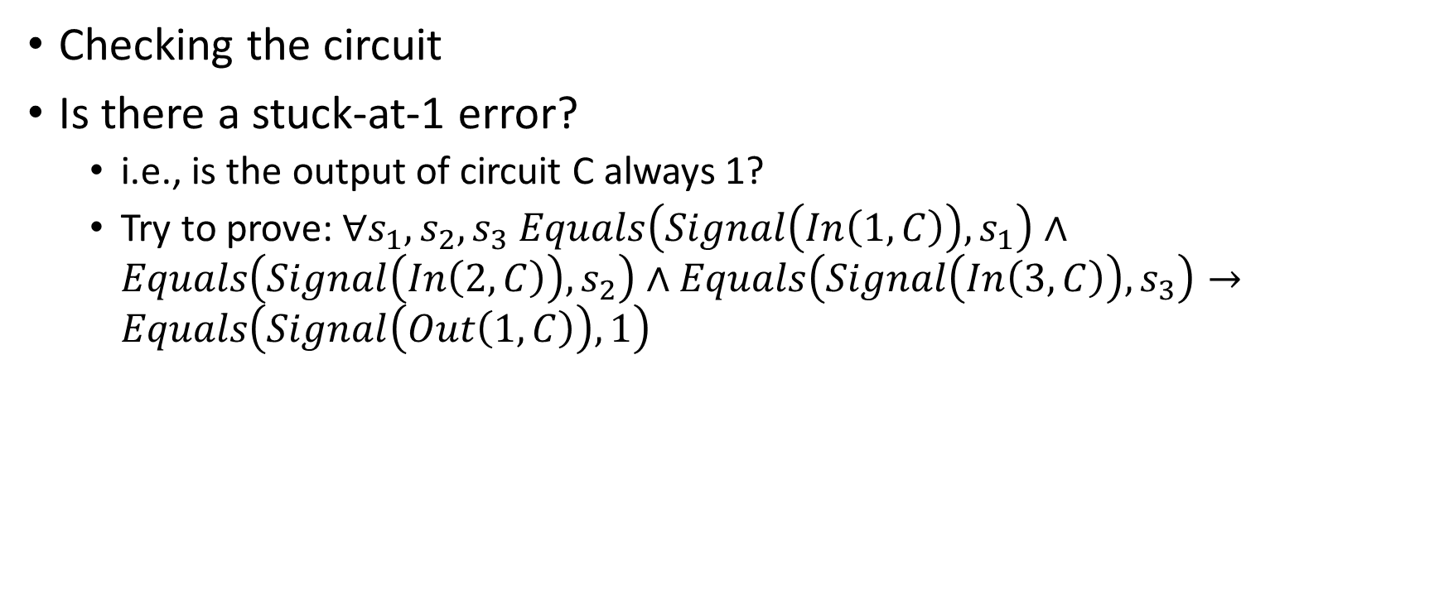
Pose queries to the inference engine
Checking the circuit
Is there a stuck-at-1 error?
i.e., is the output of circuit C always 1?
Try to prove: $∀s_{1},s_{2},s_{3} Equals\left(Signal\left(In\left(1,C\right)\right),s_{1}\right)∧Equals\left(Signal\left(In\left(2,C\right)\right),s_{2}\right)∧Equals\left(Signal\left(In\left(3,C\right)\right),s_{3}\right)→Equals\left(Signal\left(Out\left(1,C\right)\right),1\right)$

Slide 21
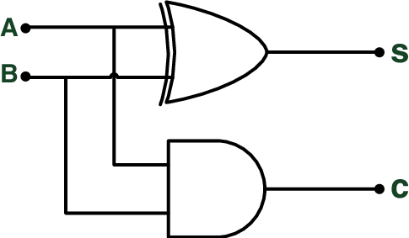
Class work
Write the FOL sentence to describe the behavior of an
OR gate
NOT gate
Write the FOL sentences to describe the (half-adder) circuit shown
Write the query to check if the outputs will always be the same
C2
X3
A3

Slide 22
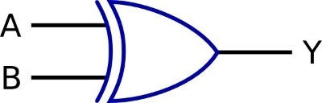
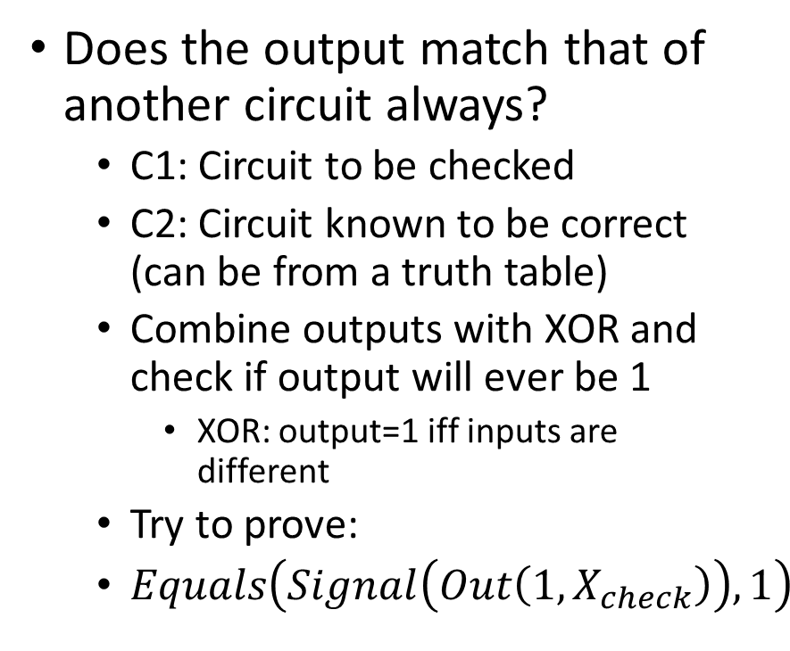
Checking the circuit
C1
Does the output match that of another circuit always?
C1: Circuit to be checked
C2: Circuit known to be correct (can be from a truth table)
Combine outputs with XOR and check if output will ever be 1
XOR: output=1 iff inputs are different
Try to prove:
$Equals\left(Signal\left(Out\left(1,X_{check}\right)\right),1\right)$
X_{check}
C2

Slide 23
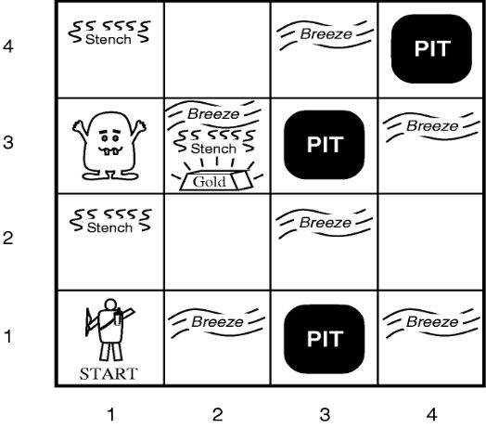
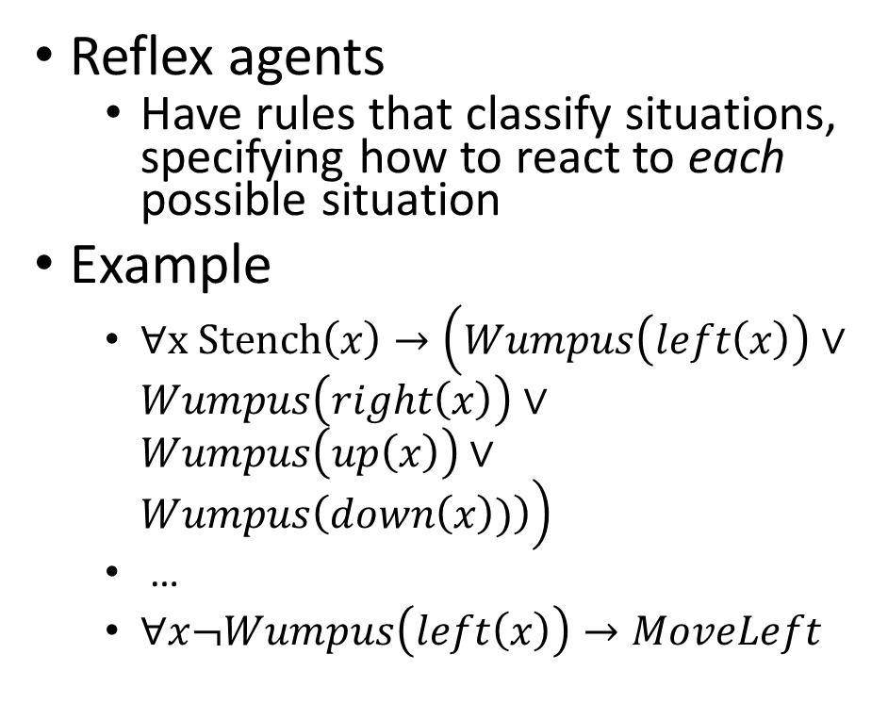
How to represent actions?
Reflex agents
Have rules that classify situations, specifying how to react to each possible situation
Example
$∀x Stench\left(x\right)→\left(Wumpus\left(left\left(x\right)\right)∨Wumpus\left(right\left(x\right)\right)∨Wumpus\left(up\left(x\right)\right)∨Wumpus\left(down\left(x\right))\right)\right)$
…
$∀x¬Wumpus\left(left\left(x\right)\right)→MoveLeft$

Slide 24
Reflex actions
Advantage
Fast!
Useful in robotics
Disadvantages
Loops – the observations will be repeated when agent returns to a square
Results in same response
Need to maintain some internal model of how the world changes because of actions

Slide 25
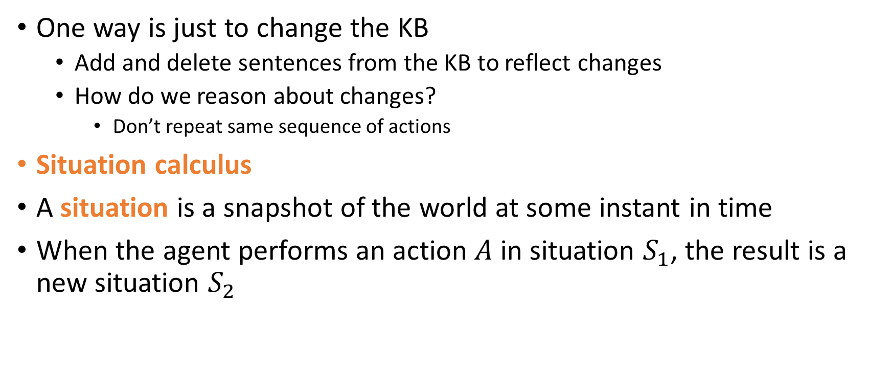
Representing change
One way is just to change the KB
Add and delete sentences from the KB to reflect changes
How do we reason about changes?
Don’t repeat same sequence of actions
Situation calculus
A situation is a snapshot of the world at some instant in time
When the agent performs an action $A$ in situation $S_{1}$, the result is a new situation $S_{2}$

Slide 26
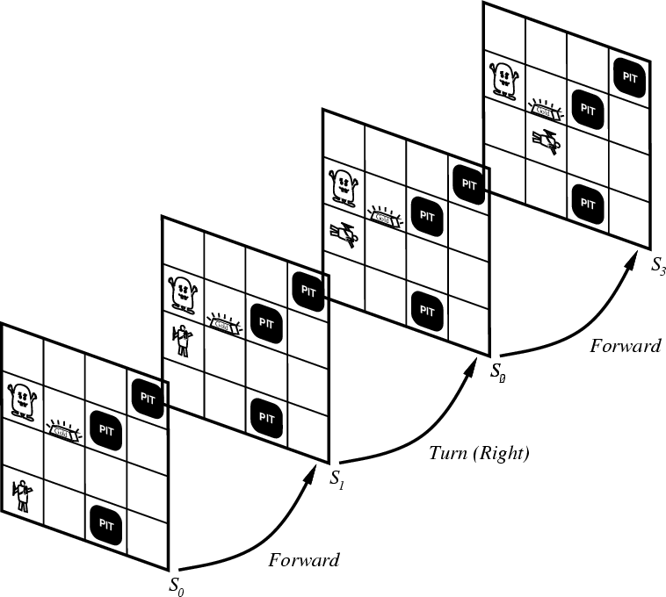
Situations

Slide 27
Situation Calculus
Situation Calculus was introduced by John McCarthy in 1969
It describes dynamic domains in Predicate Logic using
situations (denote world states; include world history)
actions (functions)
axioms (to specify actions and domain knowledge)
Planning of actions in the situation calculus is done through theorem proving
Infer a goal situation from the initial situation using the given axioms

Slide 28
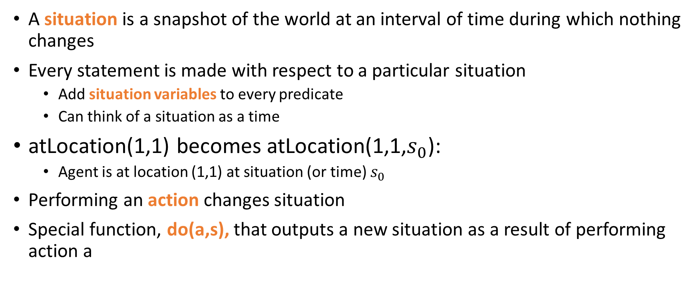
Situation calculus
A situation is a snapshot of the world at an interval of time during which nothing changes
Every statement is made with respect to a particular situation
Add situation variables to every predicate
Can think of a situation as a time
atLocation(1,1) becomes atLocation(1,1,$s_{0}$):
Agent is at location (1,1) at situation (or time) $s_{0}$
Performing an action changes situation
Special function, do(a,s), that outputs a new situation as a result of performing action a

Slide 29
Situation Calculus: example
World:
robot
Items (e.g., Ball)
locations (x,y)
Robot moves around the world by specifying target location
picks up or drops items
some items are too heavy for the robot to pick up
some items are fragile so that they break when they are dropped

Slide 30
Situation Calculus: example
Actions
move(x, y): robot is moving to a new location (x, y)
pickup(o): robot picks up an object o
drop(o): robot drops the object o that holds

Slide 31
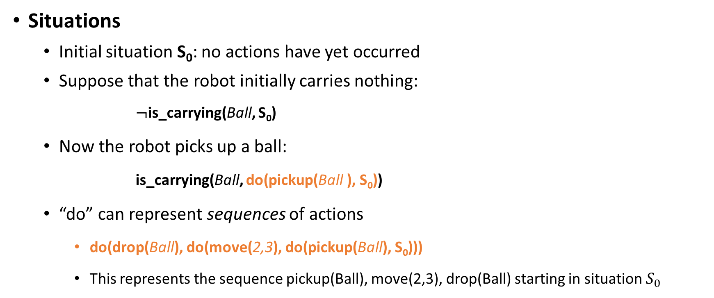
Situation Calculus
Situations
Initial situation S₀: no actions have yet occurred
Suppose that the robot initially carries nothing:
$¬$is_carrying(Ball, S₀)
Now the robot picks up a ball:
is_carrying(Ball, do(pickup(Ball ), S₀))
“do” can represent sequences of actions
do(drop(Ball), do(move(2,3), do(pickup(Ball), S₀)))
This represents the sequence pickup(Ball), move(2,3), drop(Ball) starting in situation $S_{0}$
The new situation

Slide 32
Situation Calculus
is_carrying(Ball,s)
A fluent: represents a property of the world
Predicate logic statements whose truth value may change
They take a situation as a final argument

Slide 33
Situation Calculus
Actions have preconditions
Not all actions can be performed in a situation
Precondition Axioms
Precondition(drop(o),s) ↔ is_carrying(o,s)
Precondition(pickup(o),s) ↔ (∀z ¬is_carrying(z,s) ∧¬heavy(o))

Slide 34
Situation Calculus
Actions have post-conditions (effects)
pickup(o) in s
is_carrying(o,do(pickup(o),s))
drop(o) in s ∧ fragile(o)
broken(o,do( drop(o),s))

Slide 35
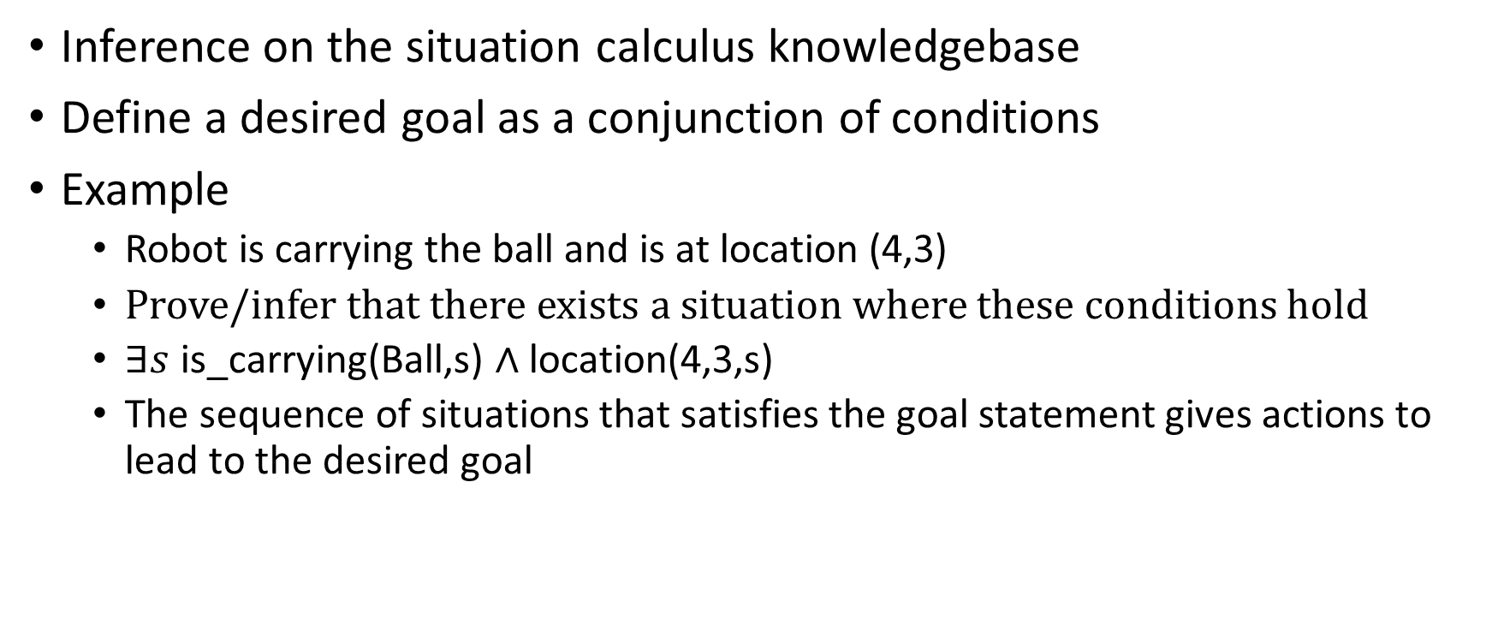
Planning a sequence of actions
Inference on the situation calculus knowledgebase
Define a desired goal as a conjunction of conditions
Example
Robot is carrying the ball and is at location (4,3)
Prove/infer that there exists a situation where these conditions hold
$∃s$is_carrying(Ball,s) $∧$ location(4,3,s)
The sequence of situations that satisfies the goal statement gives actions to lead to the desired goal

Slide 36
Problems with inference-based planning
Solution can contain irrelevant actions
Inference is slow
Resolution refutation
Practical planners restrict the language used to represent the problem
Action Languages
STRIPS
Planning as search in state space

Slide 37
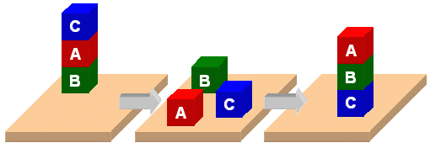
PDDL Planning Domain Description Language

Slide 38
PDDL
Planning Domain Description Language
Based on STRIPS with various extensions
First defined by Drew McDermott (Yale) et al.
Classic spec: PDDL 1.2; good reference guide
Used in biennial International Planning Competition (IPC) series (1998-2022)
Many planners use it as a standard input
Newer variants exist

Slide 39
PDDL is still widely used
PDDL is still used in many planning systems and domains as a standard for input and output
Its representation was updated, e.g. adding
fluents (facts that change over time)
preferences (aka soft constraints)
New variants support multiple agents, ontologies, continuous variables, …
Uses Lisp-style syntax

Slide 40
PDDL Representation
Task specified via two files: domain file and problem file
Domain file defines the general “rules” of the world
Independent of specifics
Rules for moving cargo between airports

Slide 41
PDDL Representation: Domain
Predicates: properties of objects
Constants: any concepts that are used (e.g., Blue, Green in a world with colors)
Actions/Operators: Each action has
Precondition
Effect

Slide 42
PDDL Example: Robot with grippers - domain
There is a robot that can move between rooms and pick up or drop balls with a gripper on its arm(s).
Predicates:
Is x a room?
Is x a ball?
Is ball x inside room y?
Is robot arm x empty? [...]
Actions/Operators:
The robot can move between rooms, pick up a ball or drop a ball.

Slide 43
PDDL Example: Robot with grippers - domain
There is a robot that can move between rooms and pick up or drop balls with a gripper on its arm(s).
Predicates:
Is x a room?
Is x a ball?
Is ball x inside room y?
Is robot arm x empty? [...]
(room ?r) (ball ?b) (gripper ?g) (at-robby ?r)
(at ?b ?r) (free ?g) (carry ?o ?g)

Slide 44
Action example
Move the robot from one room to another
(:action move
:parameters (?from ?to)
:precondition (and (room ?from)
(room ?to)
(at-robby ?from))
:effect (and (at-robby ?to)
(not (at-robby ?from))))

Slide 45
Action example
Robot picks a ball that is in a room
(:action pick
:parameters (?obj ?room ?gripper)
:precondition (and (ball ?obj)
(room ?room)
(gripper ?gripper)
(at ?obj ?room)
(at-robby ?room)
(free ?gripper))
:effect (and (carry ?obj ?gripper)
(not (at ?obj ?room))
(not (free ?gripper))))

Slide 46
Class work
Write the action for the robot dropping a ball in a room
Use these predicates:
(room ?r) (ball ?b) (gripper ?g) (at-robby ?r)
(at ?b ?r) (free ?g) (carry ?o ?g)
(:action drop
:parameters (?obj ?room ?gripper)

Slide 47
Domain in PDDL
(define (domain gripper-strips)
(:predicates (room ?r) (ball ?b) (gripper ?g) (at-robby ?r)
(at ?b ?r) (free ?g) (carry ?o ?g))
(:action move
:parameters (?from ?to)
:precondition (and (room ?from)
(room ?to)
(at-robby ?from))
:effect (and (at-robby ?to)
(not (at-robby ?from))))
(:action pick
:parameters (?obj ?room ?gripper)
:precondition (and (ball ?obj)
(room ?room)
(gripper ?gripper)
(at ?obj ?room)
(at-robby ?room)
(free ?gripper))
:effect (and (carry ?obj ?gripper)
(not (at ?obj ?room))
(not (free ?gripper))))
(:action drop
:parameters (?obj ?room ?gripper)
:precondition (and (ball ?obj)
(room ?room)
(gripper ?gripper)
(carry ?obj ?gripper)
(at-robby ?room))
:effect (and (at ?obj ?room)
(free ?gripper)
(not (carry ?obj ?gripper)))))

Slide 48
PDDL Representation: problem
Problem file: describes the details of the specific instance of a problem in the domain
Describe its
Domain
specific objects
initial state
goal state
Planner: domain + problem ➔ a plan

Slide 49
PDDL Example: Robot with grippers – problem
There are two rooms
The robot has two arms.
There are 4 balls.
Initially, all balls and the robot are in the first room.
We want the balls to be in the second room.
Objects: The two rooms, four balls and two robot arms.
Initial state:
All balls and the robot are in the first room. All robot arms are empty.
Goal specification:
All balls must be in the second room.

Slide 50
Problem in PDDL
(define (problem strips-gripper2)
(:domain gripper-strips)
(:objects rooma roomb ball1 ball2 left right)
(:init (room rooma)
(room roomb)
(ball ball1)
(ball ball2)
(gripper left)
(gripper right)
(at-robby rooma)
(free left)
(free right)
(at ball1 rooma)
(at ball2 rooma))
(:goal (at ball1 roomb)))

Slide 51
Class work
Write the PDDL problem description for this situation
There are two rooms
There are 3 balls.
The robot has one arm and it is carrying the first ball
All balls and the robot are in the first room.
We want the balls to be in the second room.
Goal specification:
All balls must be in the second room.

Slide 52
Solution to the problem
PDDL is only a format to specify the problem
It doesn’t actually solve it
Planner software
Input: domain + problem
Output: a sequence of actions from the initial state to the goal
A plan

Slide 53
Properties of Planners
A planner is sound if any action sequence it returns is a true solution
A planner is complete if it outputs an action sequence or “no solution” for any input problem
A planner is optimal if it always returns the shortest possible solution

Slide 54
Planning as Graph Search
Planning can be considered a graph search problem
Nodes/vertices = possible states
Directed edges/arcs = actions
Solution: path from the initial state (i.e. vertex) to some state (vertex) that satisfies the goal

Slide 55
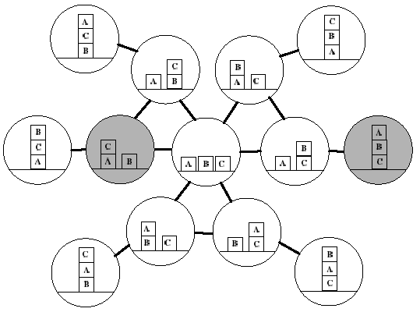
Search Space: Blocks World
Graph is finite
Initial State
Goal State

Slide 56
Planning as Graph Search
Planning is just finding a path in a graph
Why not just use standard graph algorithms for finding paths?
Answer: graphs are exponentially large in the problem encoding size
Standard graph search algorithms are polynomial in graph size
So standard algorithms would require exponential time
Can we do better than this?

Slide 57
Satisficing vs. Optimality
While finding a plan is hard in the worst case, for many planning domains, finding a plan is easy.
However finding optimal solutions can still be hard in those domains.
For example, optimal planning in the blocks world is NP-complete.
In practice, it is often sufficient to find “good” solutions “quickly” although they may not be optimal.
This is often referred to as the “satisficing” objective.

Slide 58
Satisficing solutions
How can planners do better than generic graph algorithms?
Use the compact and structured PDDL description of problems
Try to leverage structure in these descriptions to intelligently search for solutions
There are several such planning algorithms
E.g., FastForward
Most based on heuristic search
Several software implementations
Many require a linear programming solver library (e.g., CPLEX) to be installed

Slide 59
PDDL resources
https://fareskalaboud.github.io/LearnPDDL/
https://users.cecs.anu.edu.au/~patrik/pddlman/writing.html
http://pddl4j.imag.fr/pddl_tutorial.html
PDDL extension for VS Code editor
Planning as a service: cloud-hosted solver
https://solver.planning.domains/
List of planners: https://planning.wiki/ref/planners/tags
Planner software:
Planutils
PDDL4J

Slide 60
Knowledge Engineering challenges

Slide 61
The frame problem
How to specify that all conditions not affected by an action are not changed while executing that action?
In predicate logic, all such static properties need to be explicitly specified for every possible action
Frame axioms
Example:
If robot moves to (x,y) and is not holding a ball, then the location of the ball does not change
What is the problem?
A very large number of frame axioms is often necessary

Slide 62
Qualification problem
How to define every possible precondition of an action
Including exceptions that might occur
Example
When robot picks up the ball, it will hold the ball unless
The robot battery runs out, or
The gripper slips, or
The ball rolls away, or
Another robot picks the ball first, or …

Slide 63
Ramification problem
How to define every possible effect of an action
Example
When robot picks up the ball, all of these are possible
The battery drains a little bit, and
The gripper is closed, and
The ball does not roll, and
No other robot holds the ball, and …

Slide 64
Knowledge engineering
Modeling the “right” conditions and the “right” effects at the “right” level of abstraction is difficult
Automated knowledge acquisition and machine learning
Intelligent systems should be able to learn about the conditions and effects
Learn from?
Data: sensor measurements (of both causes and effects)

